Slide 1
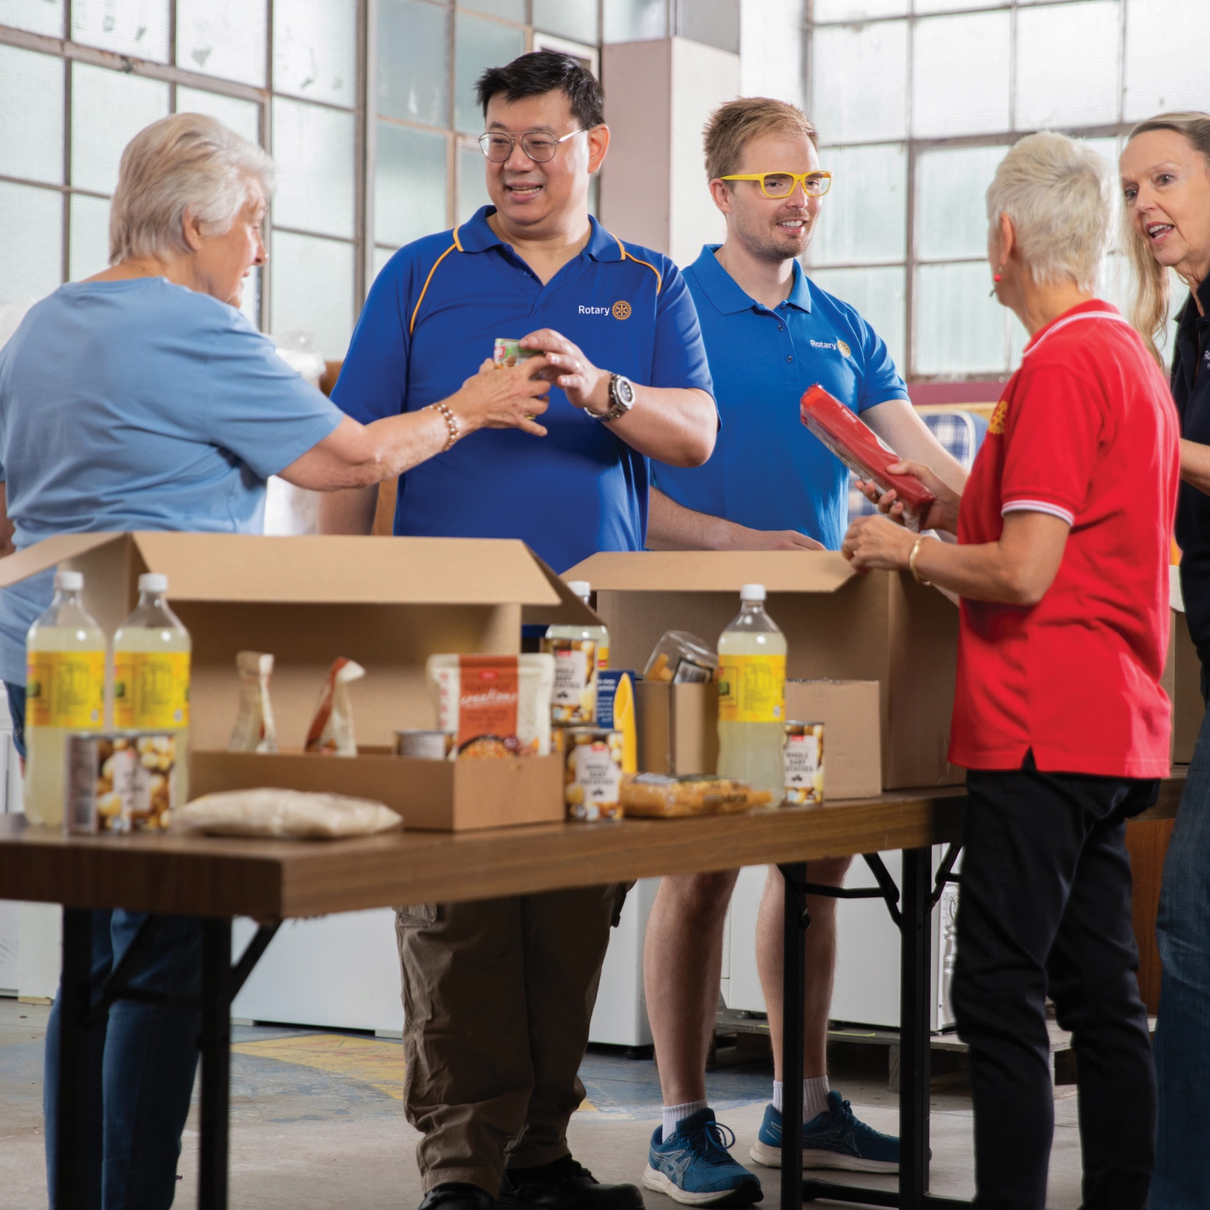
Research about the Club Experience
PETS Alliance Summer 2024

Slide 2
Data sources
2021 - 2024 Rotary All Member Surveys
2024 Rotary Action Plan Survey
2024 Public Interest Survey

Slide 3
Overall rotarian satisfaction
Notes:
Satisfaction has dropped from 94% in 2017 to 87% in 2022, but we did register a slight increase from 2021 to 2022. but still overall, most members are satisfied. That’s the good news. Generally our club experience is great. It’s our product and we should be striving to create the best product possible. The research I’ll show today is aimed at the why and the so what behind this statement:

Slide 4
The Club Experience matters more than anything else
Notes:
The Club Experience matters more than anything else for member satisfaction, retention, and recruitment. Now you may have seen this sentence, or this focus on the club experience, a lot over the last couple years. That’s because over the past few years, the Research & Evaluation team surveyed members multiple times, and a consistent theme that has emerged from these surveys is that the club experience matters for members more than anything else when it comes to retaining and attracting new members.
To put this even more explicitly,

Slide 5
A positive Club Experience is the best way to retain and attract new members
Notes:
a positive club experience is the best way to retain and attract new members.

Slide 6
Retention rate for very satisfied members:
94%
Retention rate for not at all satisfied members:
79%
Source: 2022 Rotary All Member Survey
Notes:
Just as data-based example of this, according to some analysis we did last year, 94% members who are very satisfied with their club experience stuck around a year later, while only 79% of those who were not at all satisfied stuck around. Again we’re not talking about a lot of people who are not at all satisfied

Slide 7
7
What satisfied members say
about their clubs:
What dissatisfied members say about their clubs:
Source: 2022 Rotary All Member Survey
Notes:
So back to the conclusion that the club experience matters most. This word cloud here shows what satisfied members say about their club. They're involved in the community, friendship, service projects. Whereas, dissatisfied members say these things about their clubs, like poor, difficult, declining membership, etc. [pause for reading]

Slide 8
Member satisfaction is driven most by these parts of club experience
Club meeting enjoyment
Confidence in club leadership
Satisfaction with club service
Comfort with other club members
Source: 2023 All member survey
Notes:
And you’ll see here the most important factors for overall member satisfaction, according to our 2023 all member survey. All of these relate to the club experience. Collectively, these variables work together to provide a positive club experience. [pause for reading]

Slide 9
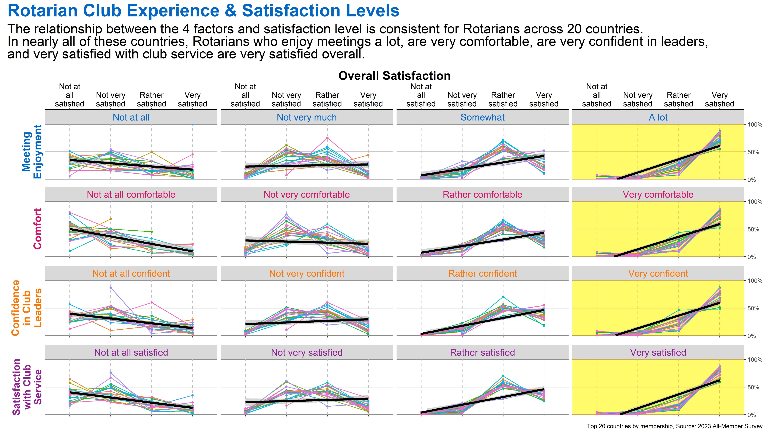
Notes:
Read slide

Slide 10
Reasons to join and stay
Notes:
And here in this graph you see that service and friendship, 2 elements of club experience, become the most important reasons for staying in a club.
Now let's look at attracting new members for a minute, these are the orange dots on the screen. Our research suggests that prospective members are first and foremost looking for service in the community as a reason to join a Rotary club.

Slide 11
Research Recommendations
Ask members what they want + listen to what they say!
Get members involved at club meetings
Do more service projects​ in your community;
Ensure club meetings have great speakers, time management, and leader engagement
Ensure your club focuses on an issue, welcomes all ages, and has considered cost of dues as a barrier to recruitment
Notes:
Ultimately, here is your call to action – let your club presidents know that the club experience really matters, and these are the best ways to improve the club experience. By doing these things, club presidents will retain more members, and potentially attract new members to clubs! These things will make clubs more inclusive, meaningful, and valuable. So please spread the word to your club presidents that these are the top ways to improve the club experience.

